Slide 1
ELECTRONIC METERS
By
Candida Nakida Mwisomba

Slide 2
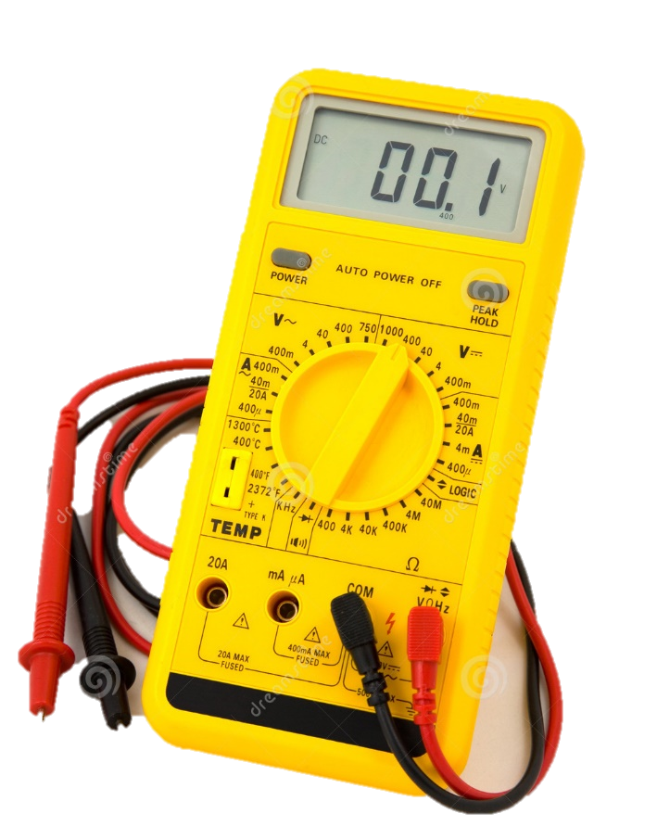
DIGITAL ELECTRONIC MEASURING INSTRUMENTS

Slide 3
Outline
Digital Voltmeters
Digital Multimeters

Slide 4
Digital voltmeter (DVM)
The digital voltmeter displays the measurements of ac or dc voltages as discrete numerals instead of a pointer deflection as in analog instruments.
It is versatile and accurate instrument that is employed in many applications.
DVM reduce the human mistakes in reading and eliminate parallax error
Smaller size & low cost
High stability
DVMs have various features such as speed, automation operation and programmability.

Slide 5
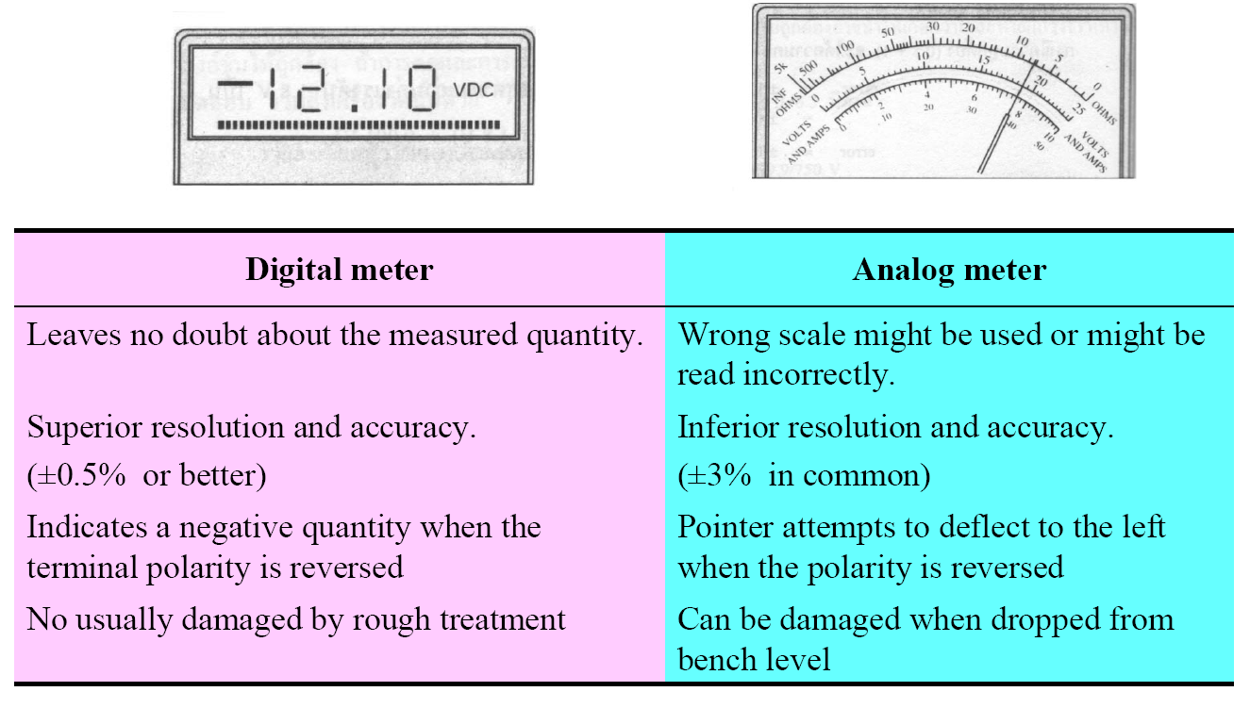
Comparison of Digital and analog meter

Slide 6
Advantages of DVM
Higher accuracy and resolution
Greater speed
No parallax
Reduced human error
Compatibility with other digital equipment for further processing and recording

Slide 7
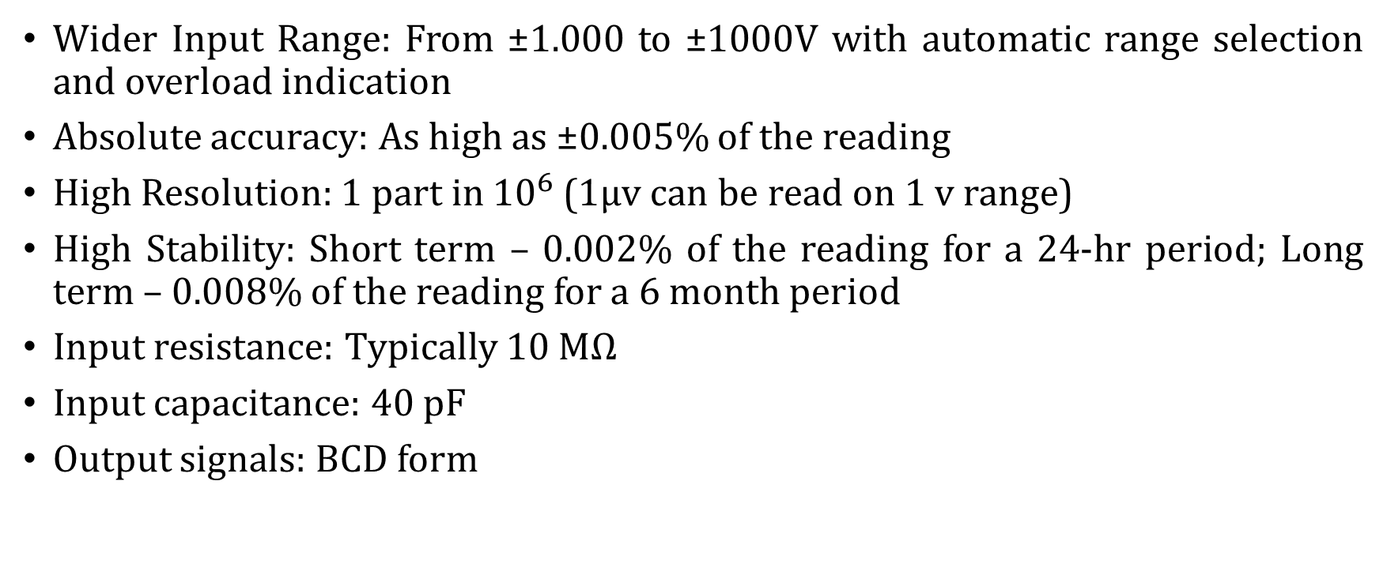
CHARACTERISTICS FEATURES OF DVMs
Wider Input Range: From ±1.000 to ±1000V with automatic range selection and overload indication
Absolute accuracy: As high as ±0.005% of the reading
High Resolution: 1 part in ${10}^{6}$ (1μv can be read on 1 v range)
High Stability: Short term – 0.002% of the reading for a 24-hr period; Long term – 0.008% of the reading for a 6 month period
Input resistance: Typically 10 MΩ
Input capacitance: 40 pF
Output signals: BCD form

Slide 8
Types of DVM
Ramp type DVM
Integrating type DVM
Dual slope integrating type DVM
Staircase ramp DVM
Successive approximation type DVM
Potentiometric type DVM
Continuous balance type DVM

Slide 9
CLASSIFICATION OF DVM
Voltage to Time
Ramp type DVM
Voltage to Frequency
Integrating type DVM
Dual slope integrating type DVM
Direct
Successive approximation type DVM
Staircase ramp DVM

Slide 10
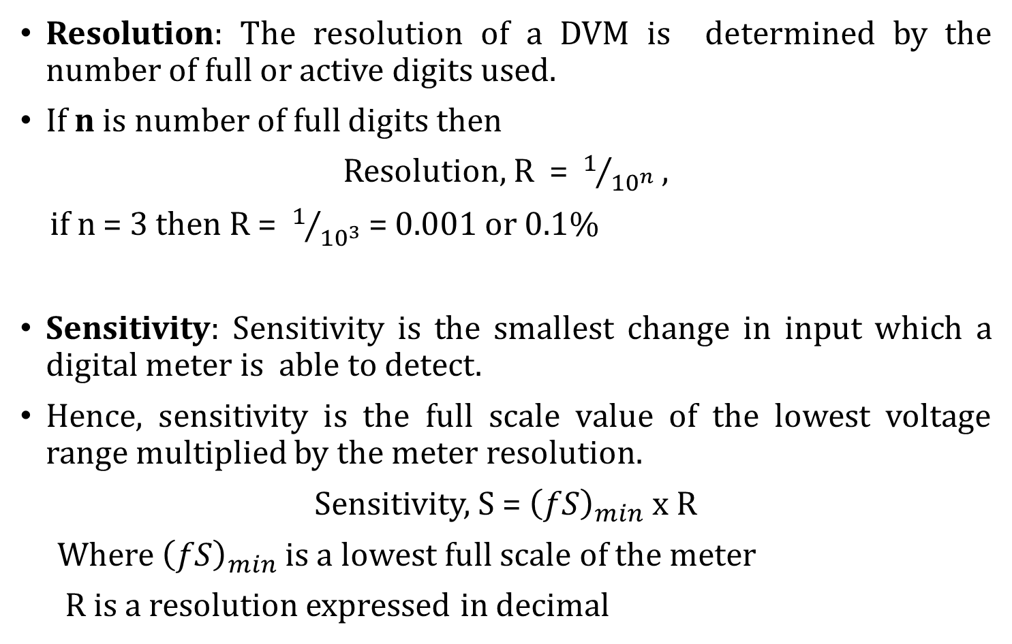
Resolution and Sensitivity of DVM
Resolution: The resolution of a DVM is determined by the number of full or active digits used.
If n is number of full digits then
Resolution, R = $1/{{10}^{n}}$ ,
if n = 3 then R = $1/{{10}^{3}}$= 0.001 or 0.1%
Sensitivity: Sensitivity is the smallest change in input which a digital meter is able to detect.
Hence, sensitivity is the full scale value of the lowest voltage range multiplied by the meter resolution.
Sensitivity, S = ${\left(fS\right)}_{min}$ x R
Where ${\left(fS\right)}_{min}$ is a lowest full scale of the meter
R is a resolution expressed in decimal

Slide 11
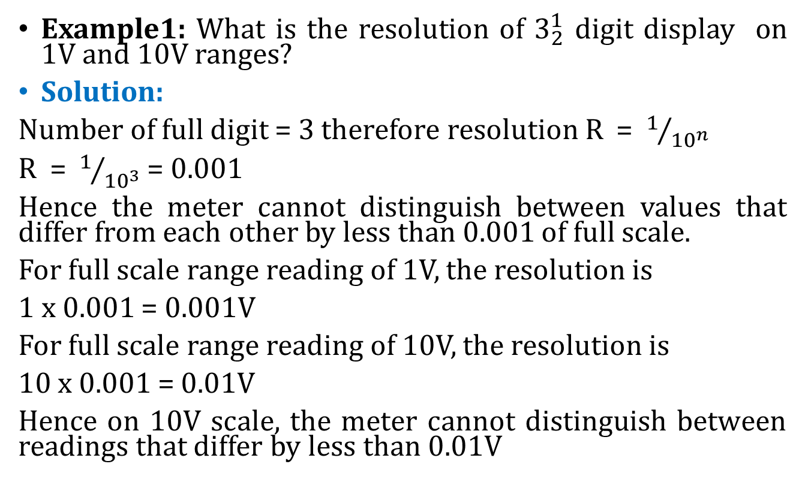
Resolution and Sensitivity of DVM
Example1: What is the resolution of $3_{2}^{1}$ digit display on 1V and 10V ranges?
Solution:
Number of full digit = 3 therefore resolution R = $1/{{10}^{n}}$
R = $1/{{10}^{3}}$ = 0.001
Hence the meter cannot distinguish between values that differ from each other by less than 0.001 of full scale.
For full scale range reading of 1V, the resolution is
1 x 0.001 = 0.001V
For full scale range reading of 10V, the resolution is
10 x 0.001 = 0.01V
Hence on 10V scale, the meter cannot distinguish between readings that differ by less than 0.01V

Slide 12
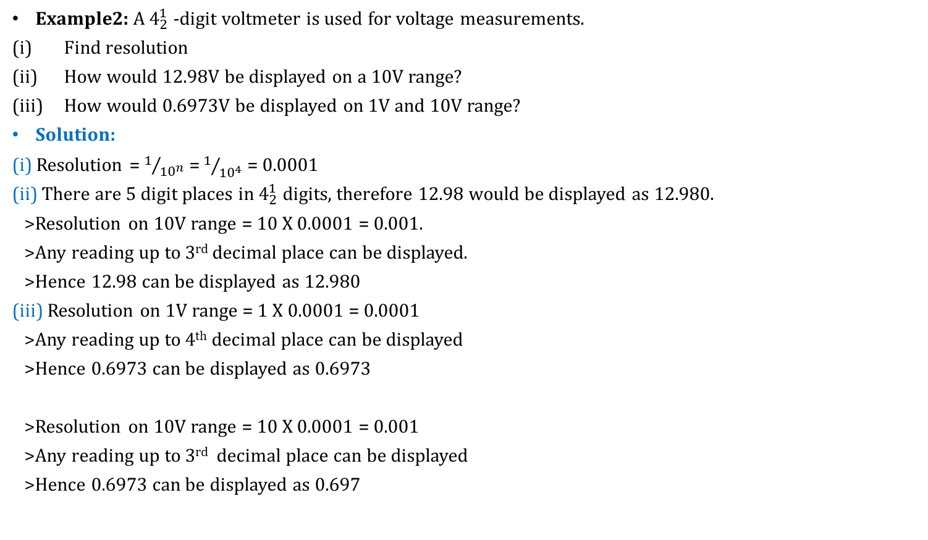
Resolution and Sensitivity of DVM
Example2: A $4_{2}^{1}$ -digit voltmeter is used for voltage measurements.
Find resolution
How would 12.98V be displayed on a 10V range?
How would 0.6973V be displayed on 1V and 10V range?
Solution:
(i) Resolution = $1/{{10}^{n}}$ = $1/{{10}^{4}}$ = 0.0001
(ii) There are 5 digit places in $4_{2}^{1}$ digits, therefore 12.98 would be displayed as 12.980.
>Resolution on 10V range = 10 X 0.0001 = 0.001.
>Any reading up to 3rd decimal place can be displayed.
>Hence 12.98 can be displayed as 12.980
(iii) Resolution on 1V range = 1 X 0.0001 = 0.0001
>Any reading up to 4th decimal place can be displayed
>Hence 0.6973 can be displayed as 0.6973
>Resolution on 10V range = 10 X 0.0001 = 0.001
>Any reading up to 3rd decimal place can be displayed
>Hence 0.6973 can be displayed as 0.697

Slide 13
DIGITAL MULTIMETER
The digital multimeter (DMM) is an instrument which is capable of measuring ac and dc voltages, ac and dc currents and several ranges of resistances.
DMM display the measured voltage using LCD or LED.
DMM displays the results in floating point format.
The basic circuit of DMM is always a dc voltage as shown in the next figure.

Slide 14
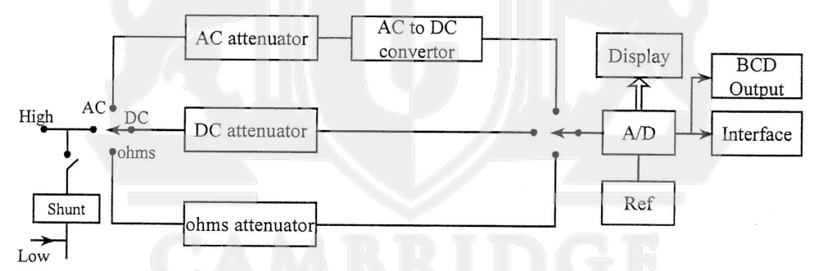
DIGITAL MULTIMETER
Basic circuit of DMM

Slide 15
DIGITAL MULTIMETER
We are now aware that the basic circuit of a digital multimeter is always a dc voltmeter.
The following arrangements are made for measuring various parameters.
The current is converted to voltage by passing it through low shunt resistor.
The ac quantities are converted to dc by employing various rectifier and filtering circuits.
For resistance measurements the meter consists of a precision low current source that is applied across the unknown resistance which gives dc voltages.
All the measured quantities are digitized using analog to digital converter and displayed form on the display.

Slide 16
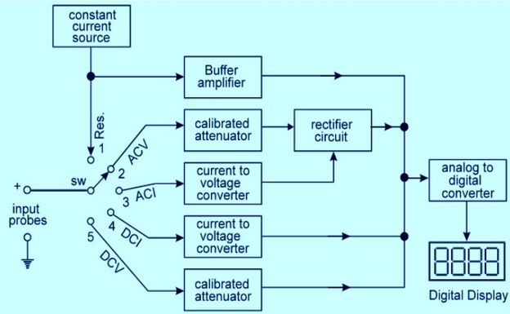
DIGITAL MULTIMETER
Block diagram of a digital multimeter

Slide 17
Parts of a DMM

Slide 18
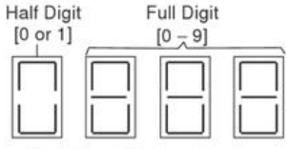
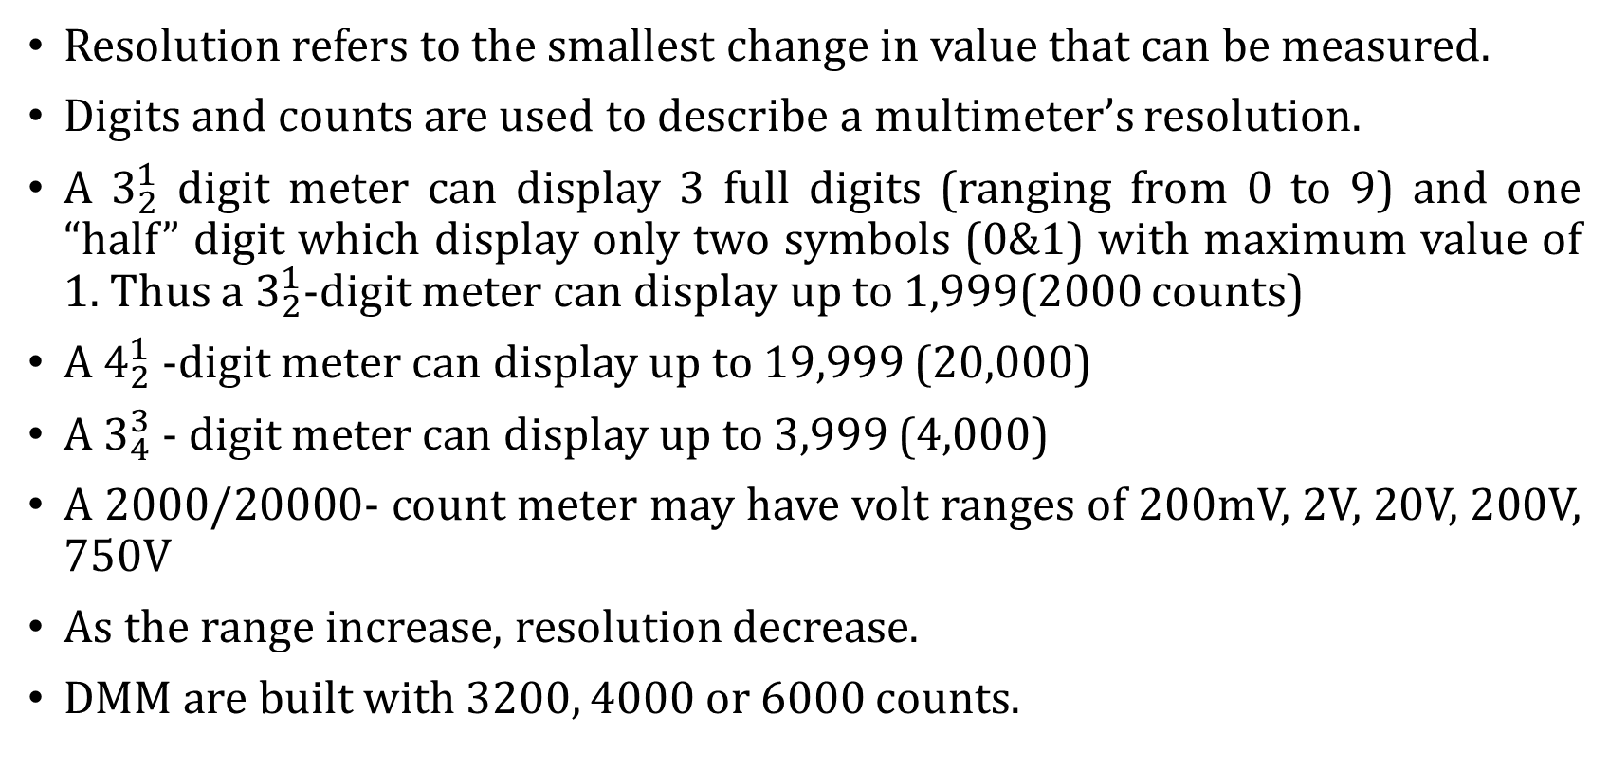
Resolution, digits and counts
Resolution refers to the smallest change in value that can be measured.
Digits and counts are used to describe a multimeter’s resolution.
A $3_{2}^{1}$ digit meter can display 3 full digits (ranging from 0 to 9) and one “half” digit which display only two symbols (0&1) with maximum value of 1. Thus a $3_{2}^{1}$-digit meter can display up to 1,999(2000 counts)
A $4_{2}^{1}$ -digit meter can display up to 19,999 (20,000)
A $3_{4}^{3}$ - digit meter can display up to 3,999 (4,000)
A 2000/20000- count meter may have volt ranges of 200mV, 2V, 20V, 200V, 750V
As the range increase, resolution decrease.
DMM are built with 3200, 4000 or 6000 counts.

Slide 19
Advantages of digital multimeter over analog multimeters
1. No loading effect since input impedance is very high.
2. Very high accuracy.
3. An unambiguous reading
4. Cost is less due to improvement in the integrated technology.
5. Available in very small size.
6. Has very good resolution

Slide 20
QUESTIONS
???

